Slide 1
PART II NONLINEAR ARX IDENTIFICATION at SYSTEM IDENTIFICATION
TECHNICAL UNIVERSITY OF CLUJ-NAPOCA FACULTY OF AUTOMATION AND COMPUTER SCIENCE
Students: Bodea Victor Lucian Group: 30332
Colda Andreea Ariana Indicies: 01/01
Guran Delia

Slide 2
Contents
Introduction
Algorithm
Solution
Results

Slide 3
Introduction

Slide 4
Nonlinear ARX models are an extension for the linear ARX models to a nonlinear case.
Problem statement: solving a black-box model using a polynomial, nonlinear ARX model, for configurable model orders (na, nb), delay (nk) and polynomial degree (m).
Two sets are given: identification and validation data.
The model is used for:
one-step-ahead prediction
simulation

Slide 5
Algorithm

Slide 6
For the beginning, the identification data is used to find the regressors, phi, and the parameters, theta.
The regressors are combinations with repetition, between the outputs and the inputs.
The parameter vector is computed with linear regression using the formula:
Theta = regressors\outputs
The parameters are unique and used for both prediction and simulation.
The difference between the prediction and simulation is that for the simulation, the real outputs are unknown and the previous outputs of the model itself are used and for the prediction, the outputs are the ones from the data set.

Slide 7

Example
For m = 2
The nonlinear ARX model is:
y(k) = ${\text{θ}}_{1}$y(k-1) + ${\text{θ}}_{2}$u(k-1) + ${\text{θ}}_{3}{\text{y}\text{(}\text{k}\text{−1)}}^{2}$ + ${\text{θ}}_{4}{\text{u}\text{(}\text{k}\text{−1)}}^{2}$ + ${\text{θ}}_{5}$u(k-1)y(k-1) + ${\text{θ}}_{6}$
Where:
${\text{θ}}_{1}$,${\text{θ}}_{2}$,${\text{θ}}_{3} ,{\text{θ}}_{4}$, ${\text{θ}}_{5}$, ${\text{θ}}_{6} −$ parameters of the model;
y – output;
u – input.

Slide 8
Solution

Slide 9
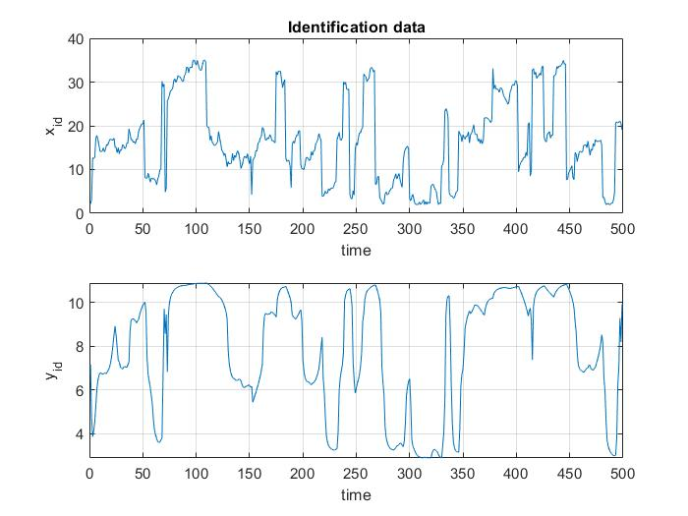
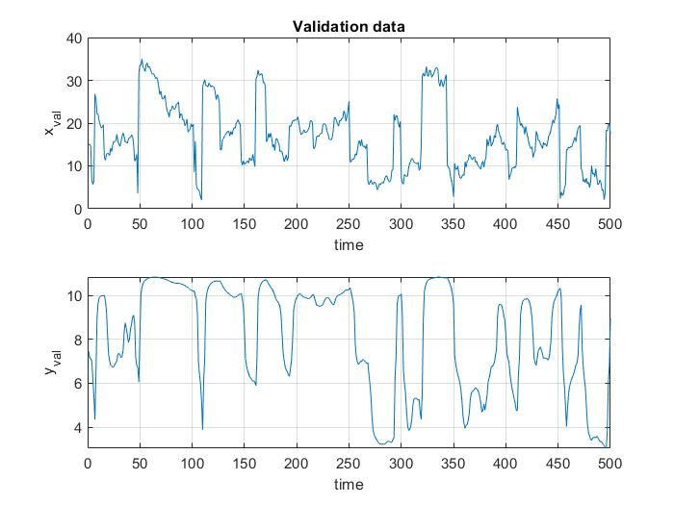
Identification and Validation Data

Slide 10
One-step-ahead Prediction
The algorithm represents a direct column x column multiplication, in order to obtain the rest of the elements of the polynomials.
The phi matrix obtained with the given data will not change and an auxiliar matrix, which has initially the exact form of phi matrix, will change at each m degree.
At the end, a column of ones is added – this is mandatory for all m-degree cases.

Slide 11
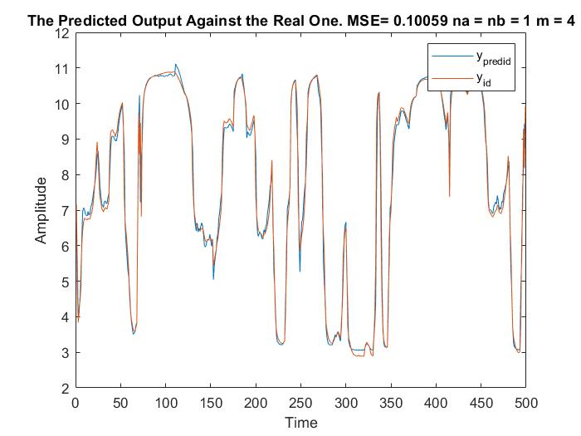
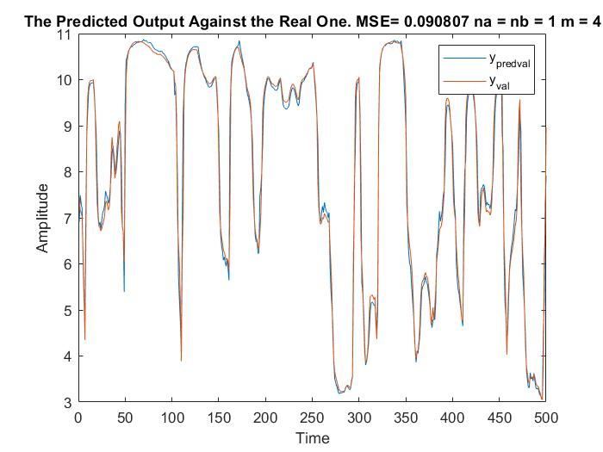
One-step-ahead Prediction (Continued)
The best model obtained for prediction for the validation dataset (right).
na = nb =1 and m = 4

Slide 12
Simulation
The algorithm is pretty much the same as the one from prediction, but there are two differences:
Each row is calculated one after the other (the elements of the polynomial for each row are added in the same procedure as for the prediction).
Previous simulated signals are used instead of given data.

Slide 13
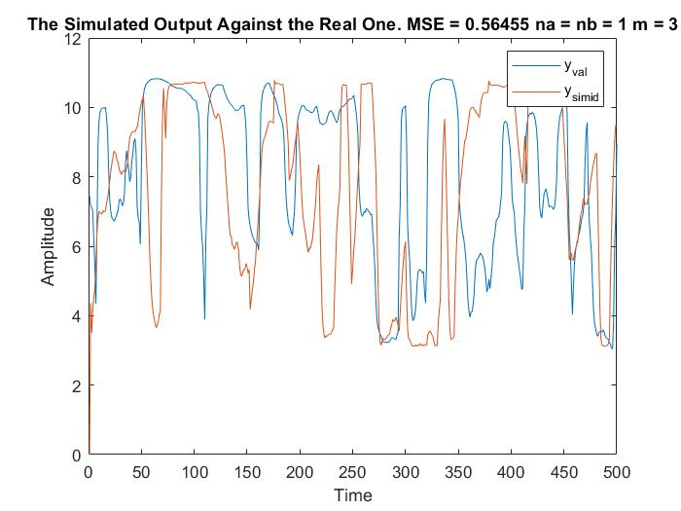
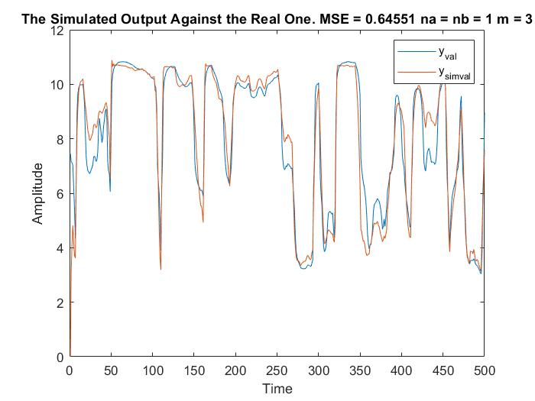
Simulation (Continued)
The best model obtained for simulation for both identification (left) and validation (right) dataset.
na = nb =1 and m = 3

Slide 14
Results

Slide 15
The Quality of the Model
The minimum of the mean-squared error:
For prediction is 0.0908, which corresponds to the model orders na = nb = 1 and the degree of the polynomial m = 4.
For simulation is 0.6455, which corresponds to the model orders na = nb = 1 and the degree of the polynomial m = 3.

Slide 16
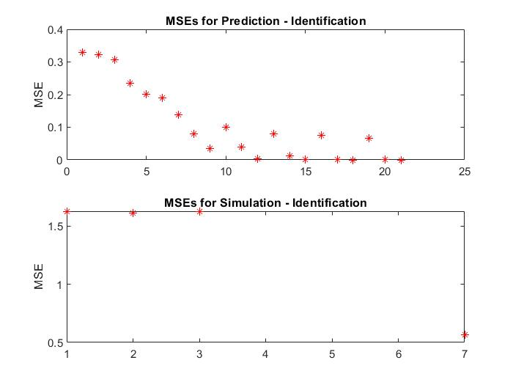
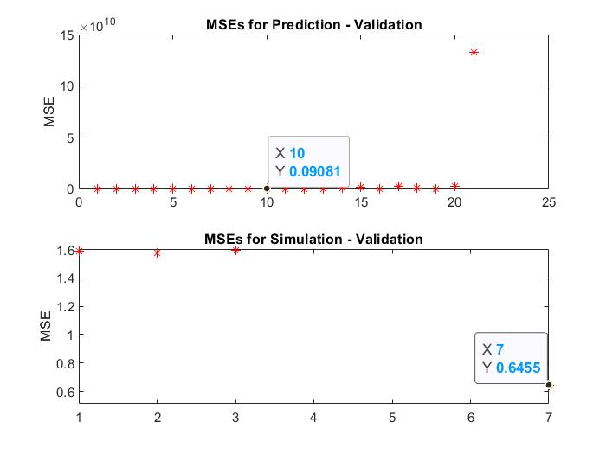
Representative plots for MSEs

Slide 17
Conclusion
Prediction:
For the training dataset, the bigger the polynomial degree and the model order, the smaller the MSE.
For the validation dataset, when the degree of the polynomial and the model order are increased, the results are getting better, with a languishing MSE, for a while but then the MSE is also growing.
Simulation:
For both datasets, when the errors accumulate, the NaN (Not a Number) appears, this happens at unstable systems.

